Slide 1
Lecture #4
By: Aqib Rehman

Slide 2
outline
Conditional Output
Forms Revisited
Functions as Props

Slide 3
Conditional Output

Slide 4
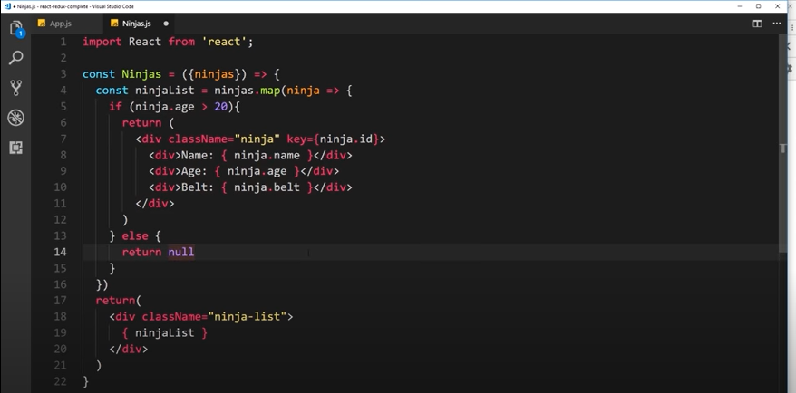

Slide 5
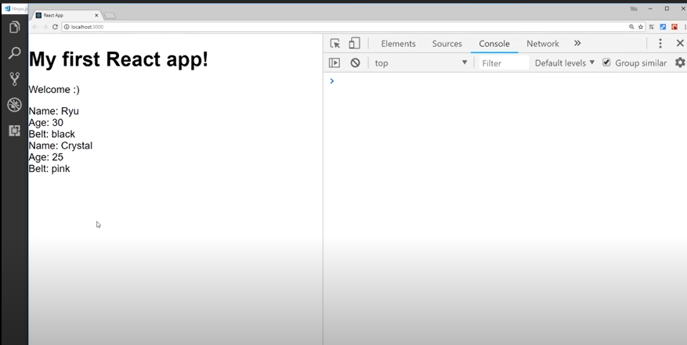

Slide 6
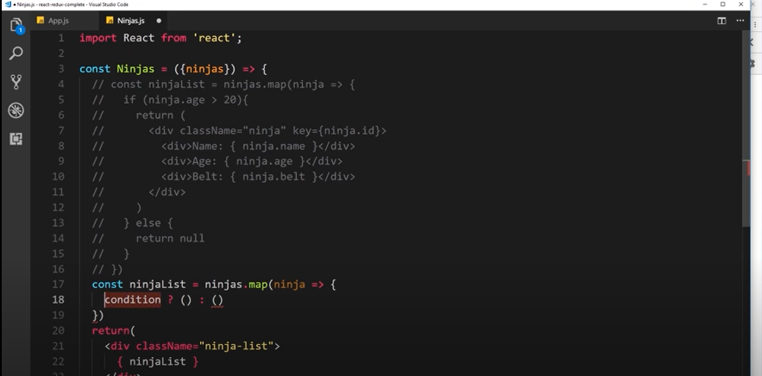

Slide 7
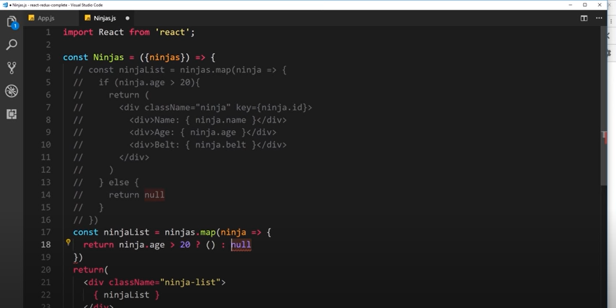

Slide 8
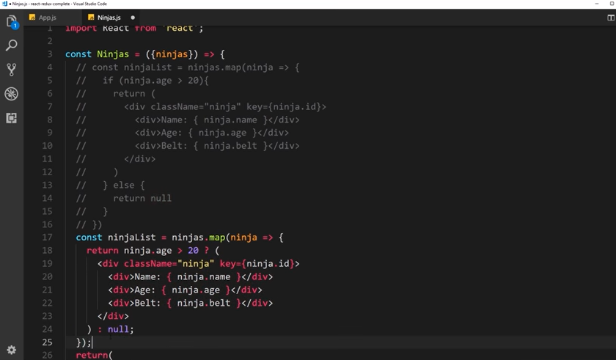

Slide 9
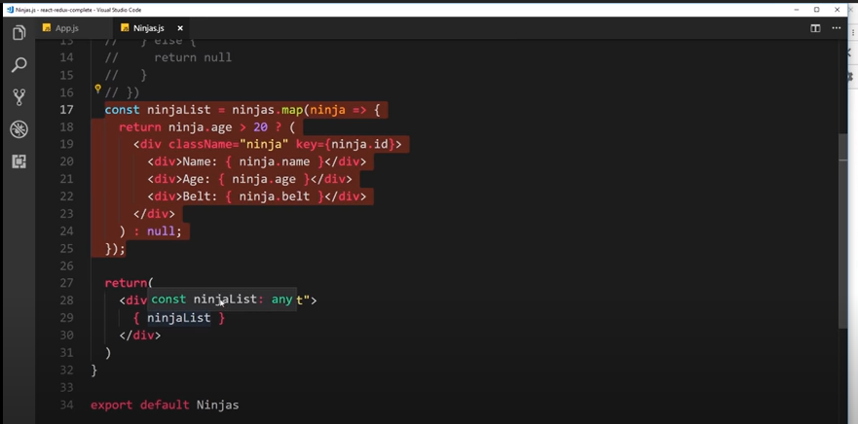

Slide 10
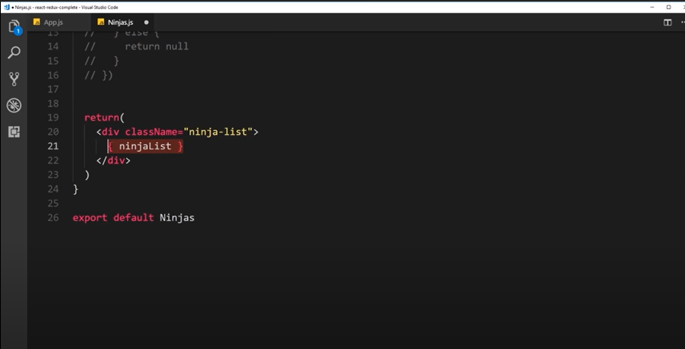

Slide 11
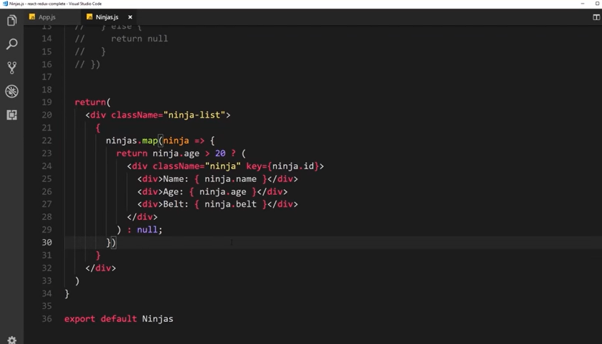

Slide 12
Forms Revisited

Slide 13
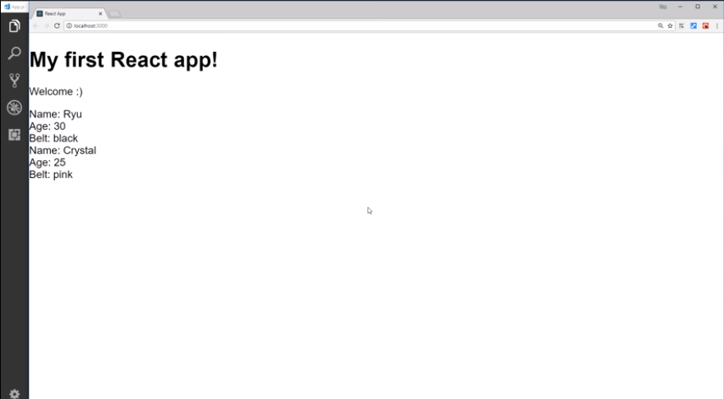
What we have already

Slide 14
What we gonna do
A form in which user can add new ninja of his/her choice.
Programmatically how?
What if by some method we update the ninjas list which we have defined in state of App comp.
This list passes as props to Ninjas comp, where it is iterate and show on the screen.
So when list will be updated the updated one will be sent to Ninjas component and that will be shown to the user.
So lets create a form with 3 fields for name, age, belt and add button.

Slide 15
Create a new component with name AddNinja

Slide 16
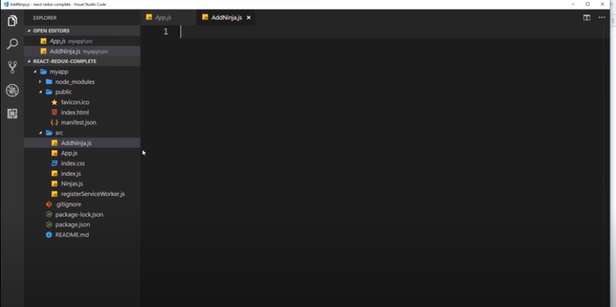

Slide 17
What will be type of this comp container or stateless?

Slide 18
As we want to store user input values locally in the state so container comp will be used

Slide 19
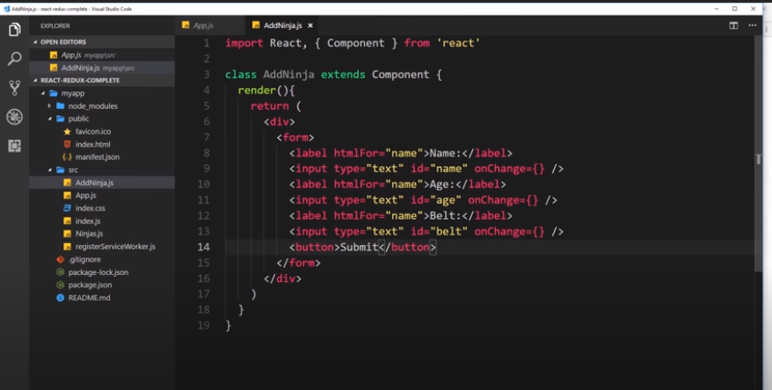
htmlFor in jsx template not for

Slide 20
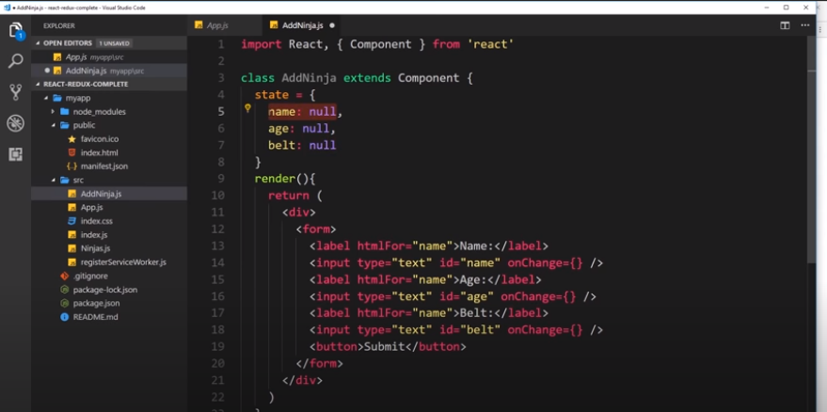
Define state

Slide 21
Need 3 functions for each field.
Right?
No

Slide 22
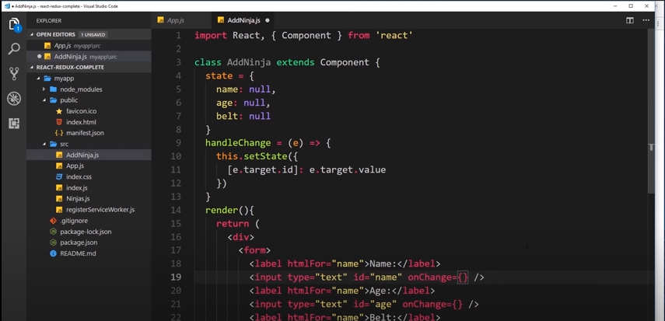

Slide 23
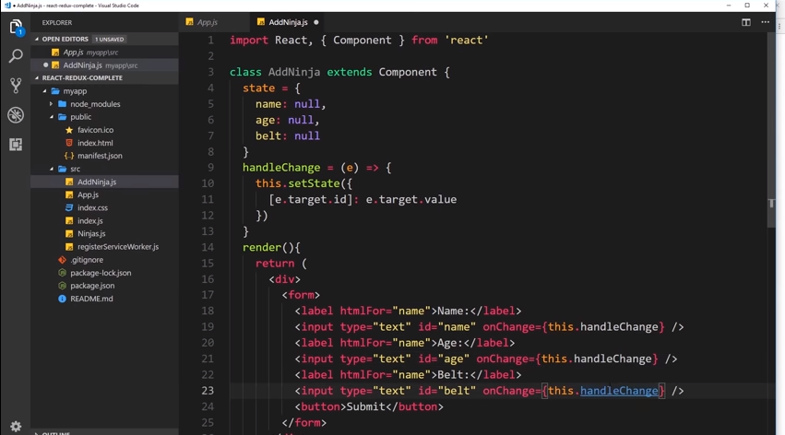
Calling handleChange func

Slide 24
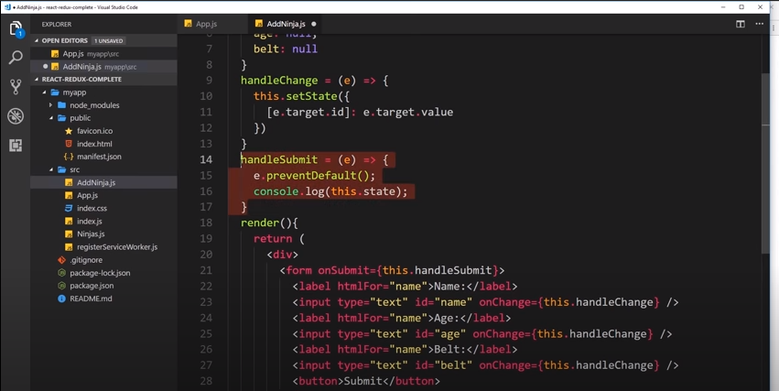
hanldeSubmit func

Slide 25
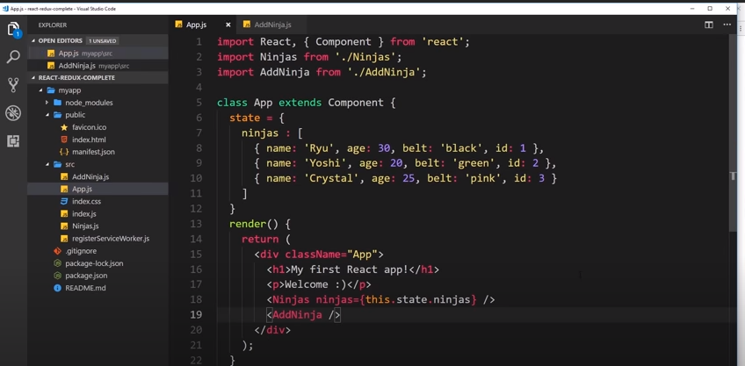
Adding AddNinja comp in the root comp

Slide 26
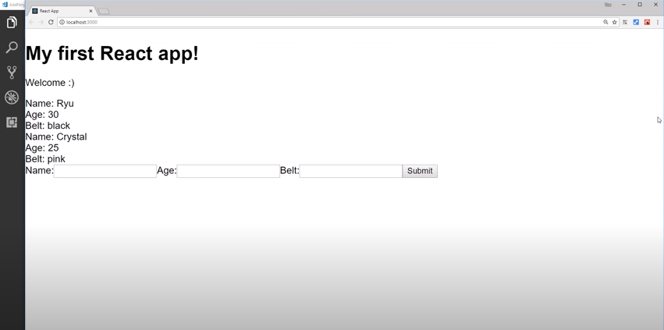

Slide 27
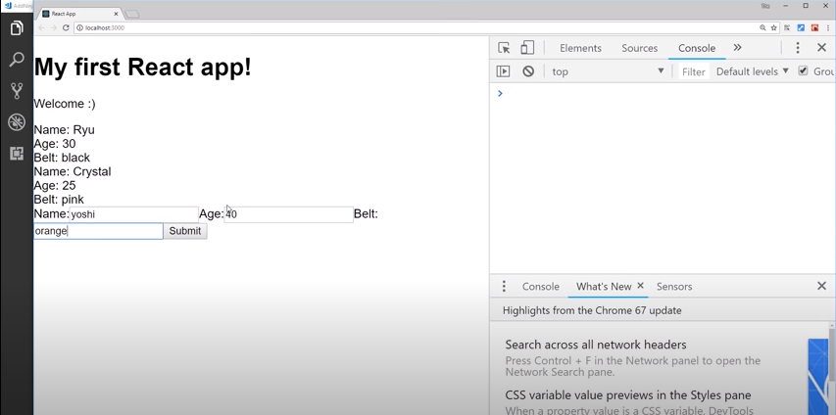

Slide 28
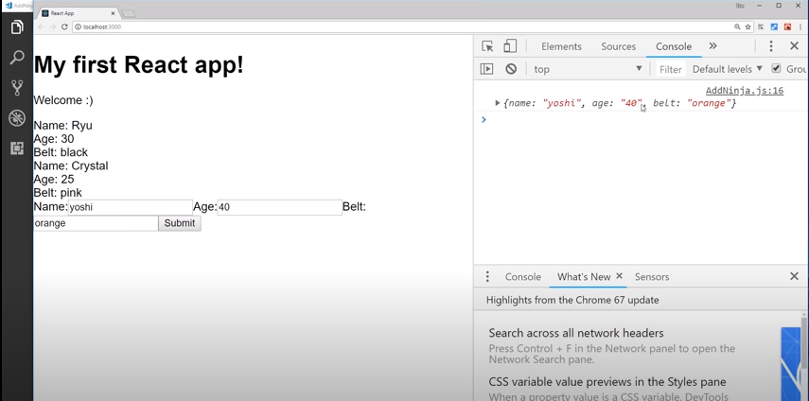

Slide 29
Now what we need:
We need to add the stuff which we got in the last slide from the user to the nijas list which we mentioned in the start.
But how?

Slide 30
Functions as Props

Slide 31
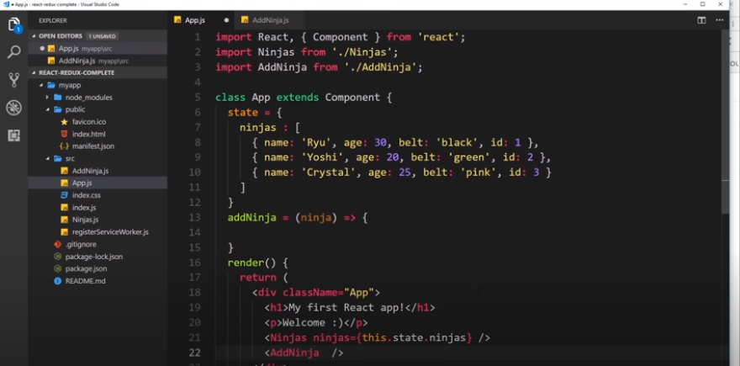

Slide 32
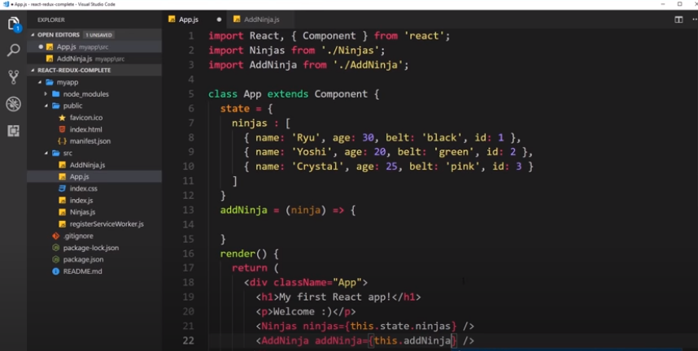

Slide 33
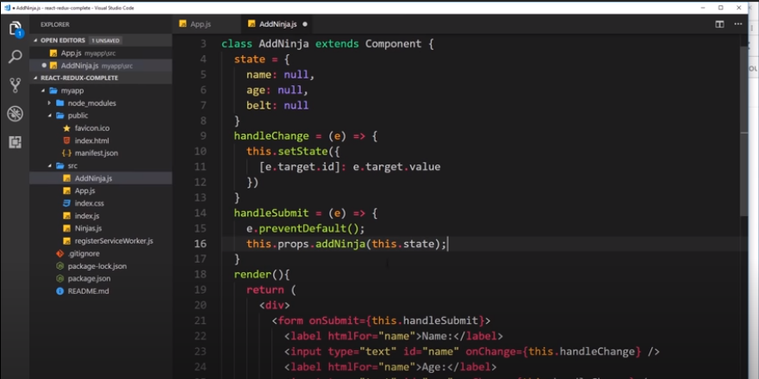
Calling a func and passing a ninja obj through state

Slide 34
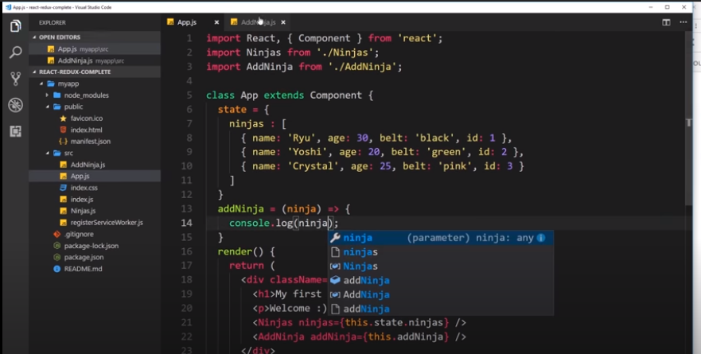

Slide 35
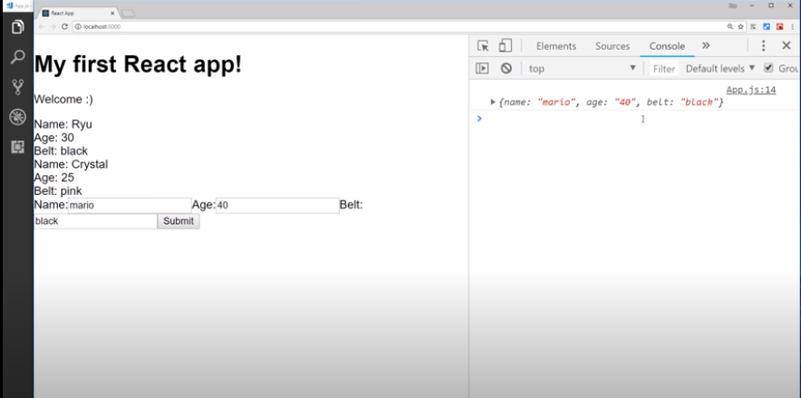

Slide 36
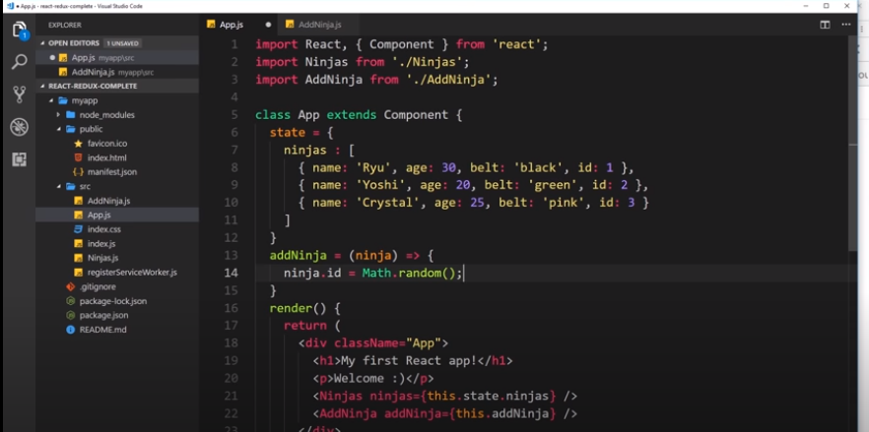
Adding id in ninja obj as we are not interested to take it from user

Slide 37
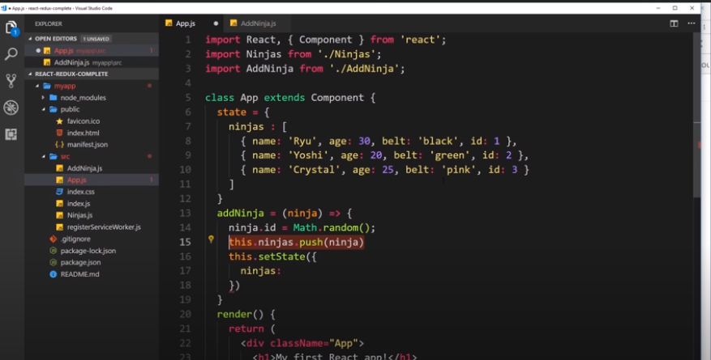
Not do this already updating array what of setState

Slide 38
Do not alter the state without setState

Slide 39
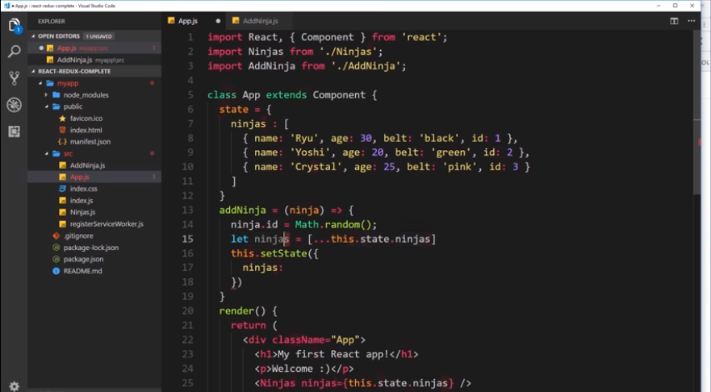
Generate a copy

Slide 40
<!DOCTYPE html>
<html>
<body>
<script>
const numbers = [1, 2, 3, 4, 5, 6];
const [one, two, ...rest] = numbers;
document.write("<p>" + one + "</p>");
document.write("<p>" + two + "</p>");
document.write("<p>" + rest + "</p>");
</script>
</body>
</html>

Slide 41
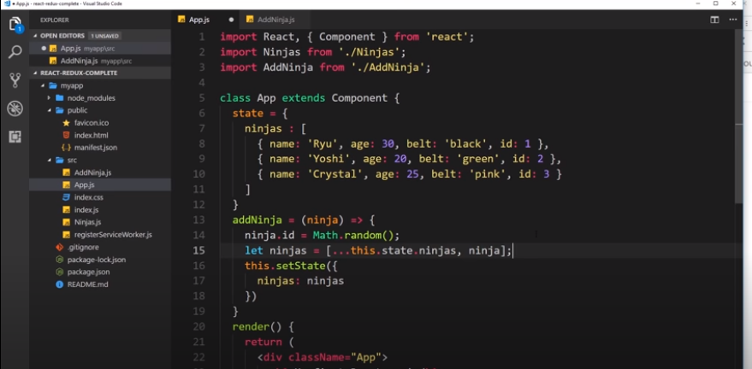

Slide 42
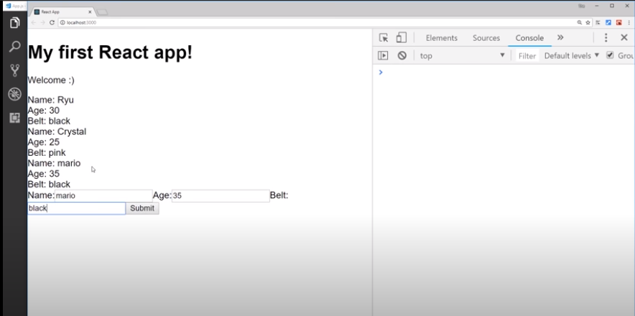

Slide 43
Add delete Ninja functionality in current code

